Slide 1
An Efficient IDS Framework for DDoS Attacks in SDN Environment May 2021 IEEE Access 8 citations
Rohullah Jahanafrooz
1401/09/18

Slide 2
Definitions
SDN:
Benefits: control, program, scalability, adaptive, dynamic
defects: centralized, dummy switches

Slide 3
D3
DPDK based DDoS detection implemented as NFV (no hardware-dependent)
An lightweight statistical anomaly algorithm that is based on a single parameter implemented some parts of it in Data-Plane.

Slide 4
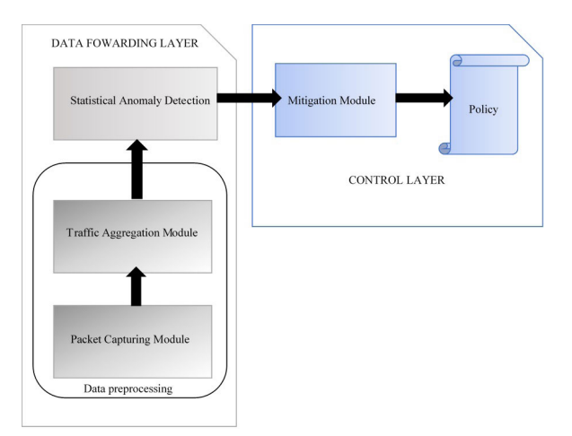
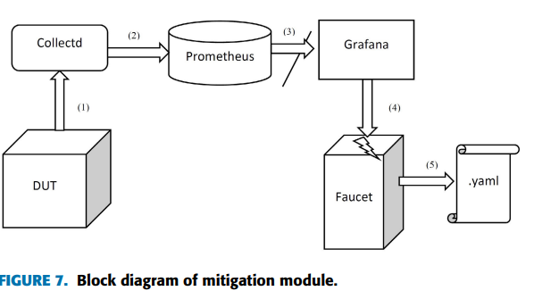
Architecture

Slide 5
Implementation
OVS-daemon
PacketGen
OVS-daemon
host
AttackGen
DUT
D3
OVS DB
OVS-Controller
Faucet
Docker

